Slide 1

YouTube Engagement Metrics

Slide 2
Overview
Objective
Understanding views, likes, dislikes, and comments
Analyzing how often they occur
Effects of their correlations to trending videos
Takeaways

Slide 3

Objective
We are looking at Trending YouTube Video Statistics and analyzing metadata that pertains to the videos' viewer engagement. We want to map out the relationship between the different metadata and see if there are any correlations.

Slide 4

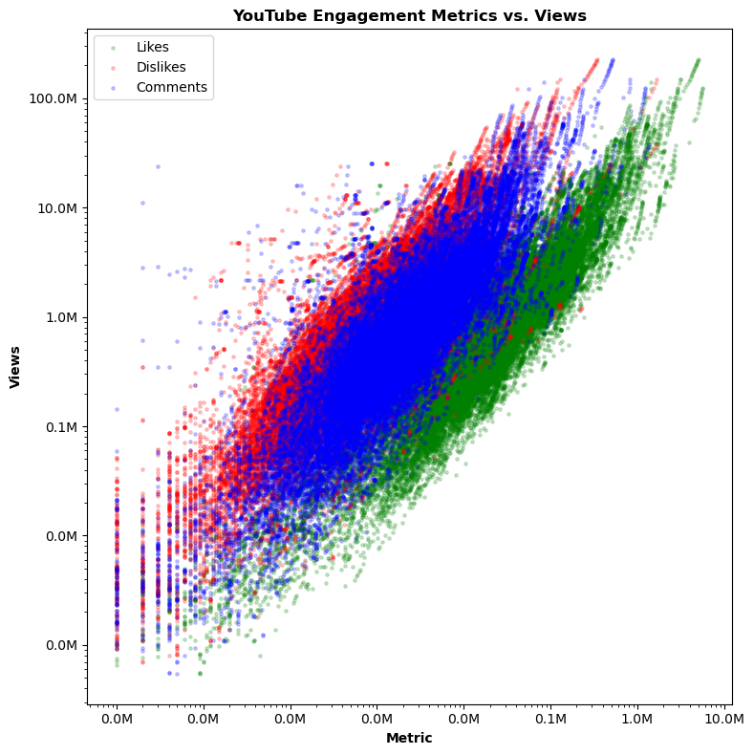
Enhancing your presentation

Slide 5
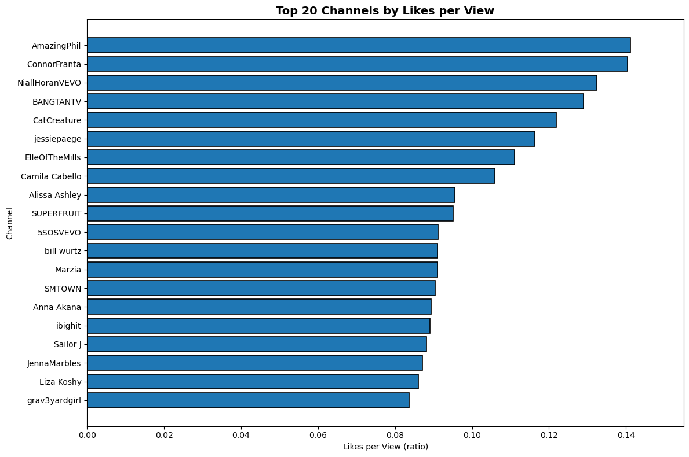
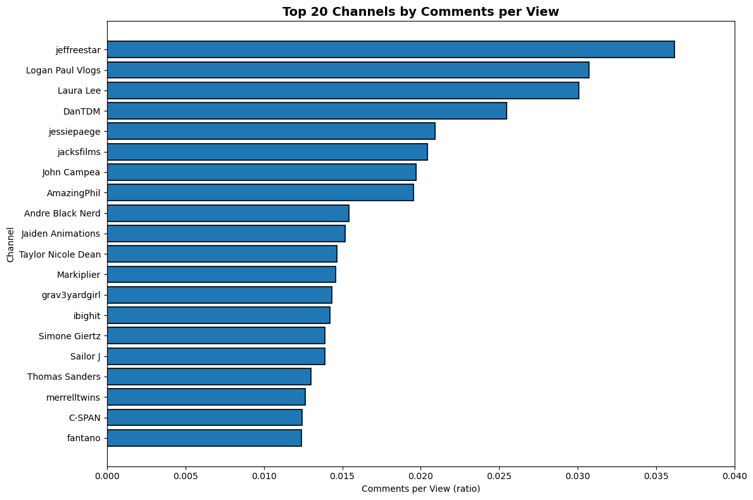
Enhancing your presentation

Slide 6
Enhancing your presentation

Slide 7
Enhancing your presentation

Slide 8
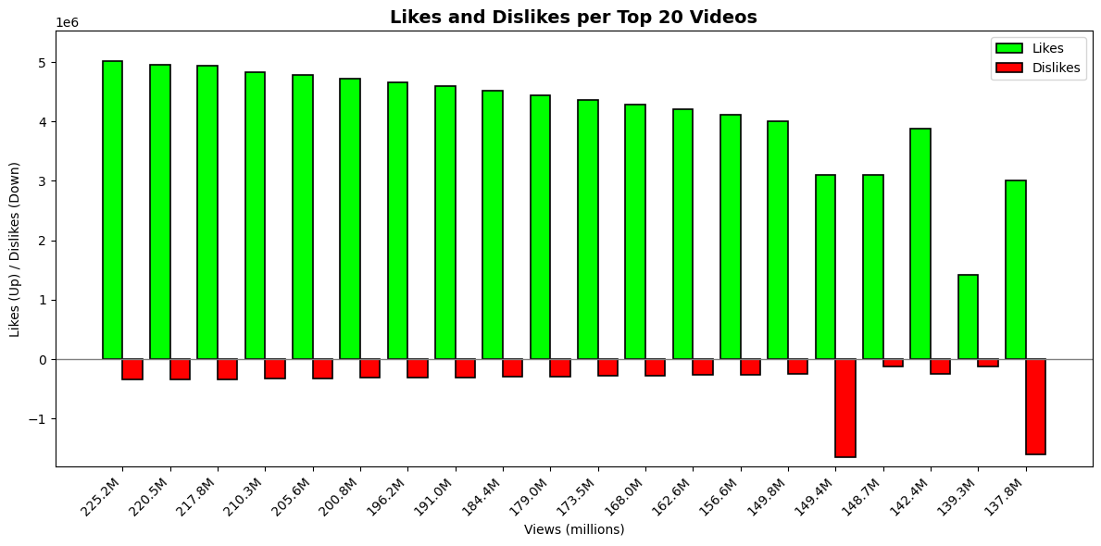
Enhancing your presentation

Slide 9
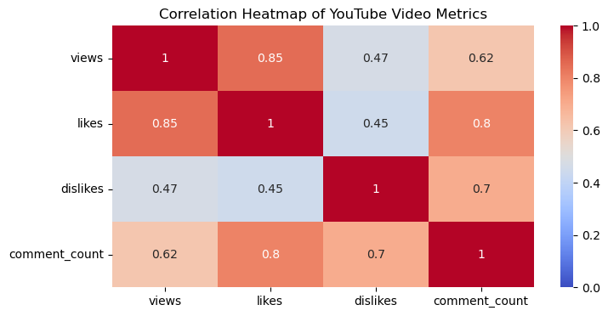
Enhancing your presentation

